Slide 1

KNN Algorithm

Slide 2
KNN
K-Nearest Neighbour is based on Supervised Learning technique.
K-NN algorithm assumes the similarity between the new case/data and available cases and put the new case into the category that is most similar to the available categories.
K-NN algorithm stores all the available data and classifies a new data point based on the similarity. This means when new data appears then it can be easily classified into a well suite category by using K- NN algorithm.
K-NN algorithm can be used for Regression as well as for Classification but mostly it is used for the Classification problems.

Slide 3
KNN
K-NN is a non-parametric algorithm, which means it does not make any assumption on underlying data.
It is also called a lazy learner algorithm because it does not learn from the training set immediately instead it stores the dataset and at the time of classification, it performs an action on the dataset.
KNN algorithm at the training phase just stores the dataset and when it gets new data, then it classifies that data into a category that is much similar to the new data.
Example: Suppose, we have an image of a creature that looks similar to cat and dog, but we want to know either it is a cat or dog. So for this identification, we can use the KNN algorithm, as it works on a similarity measure. Our KNN model will find the similar features of the new data set to the cats and dogs images and based on the most similar features it will put it in either cat or dog category.

Slide 4
KNN
It is best shown through example!
Imagine we had some imaginary data on Dogs and Horses, with heights and weights.

Slide 5
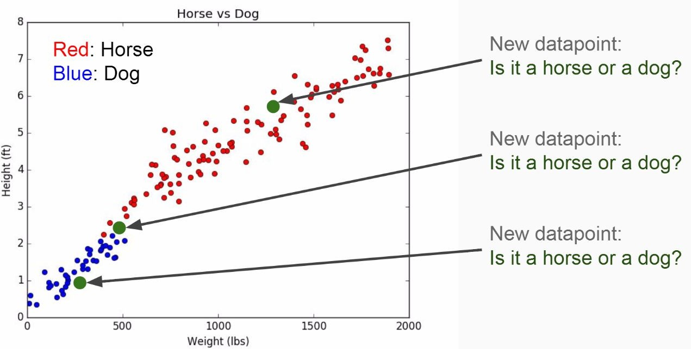
KNN

Slide 6
KNN
Training Algorithm:
1. Store all the Data
Prediction Algorithm:
Calculate the distance from x to all points in your data
Sort the points in your data by increasing distance from x
Predict the majority label of the “k” closest points

Slide 7
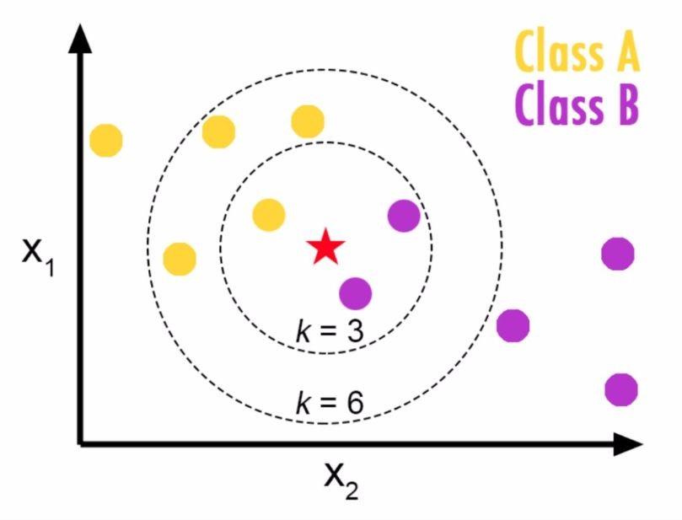
KNN
Choosing a K will affect what class a new point is assigned to:

Slide 8
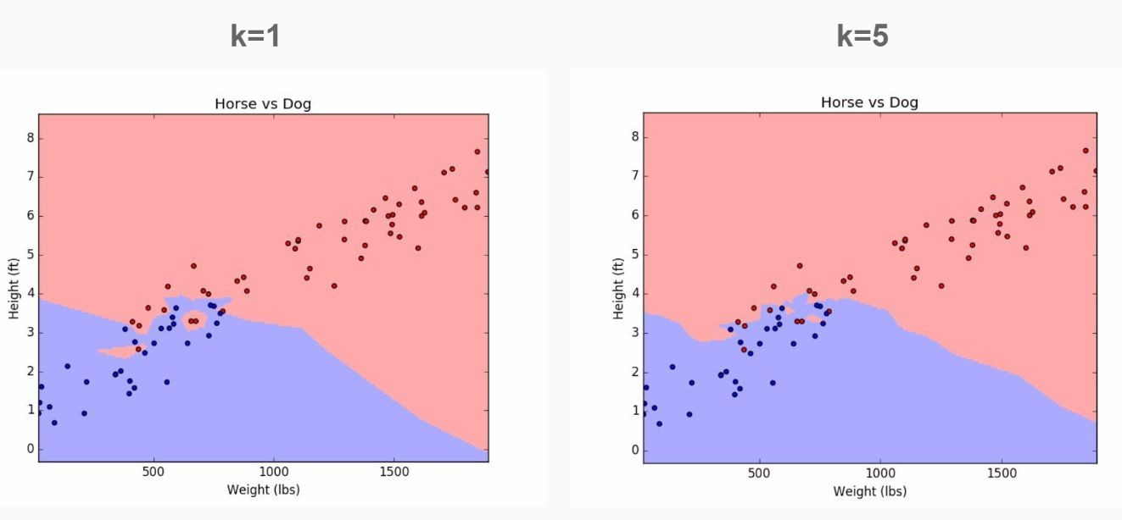
KNN
Choosing a K will affect what class a new point is assigned to:

Slide 9
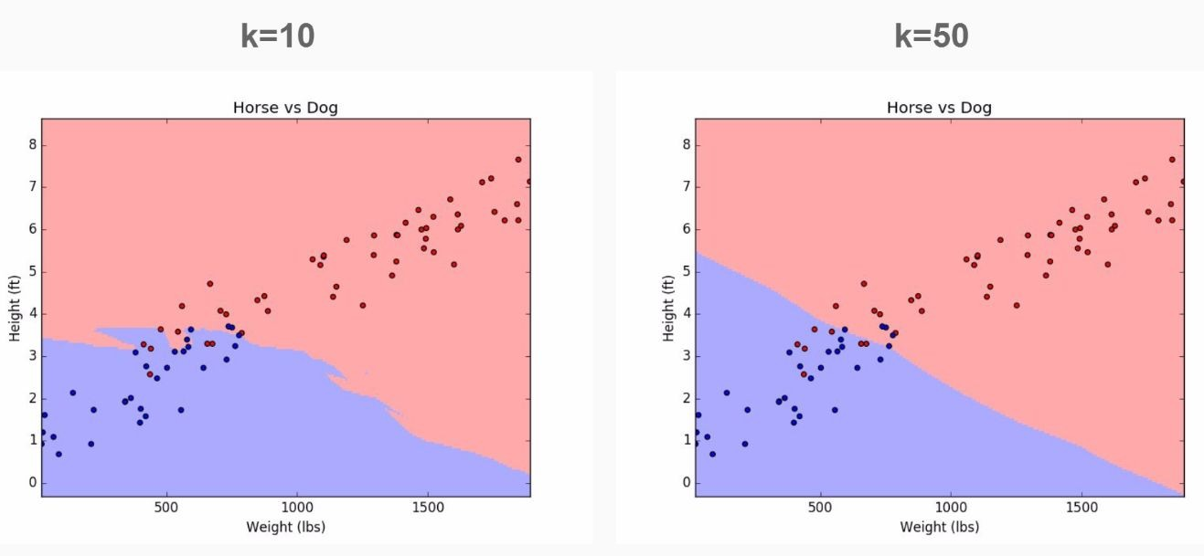
KNN
Choosing a K will affect what class a new point is assigned to:

Slide 10
Choosing the right value of k → https://towardsdatascience.com/machine-learning-basics-with-the-k-nearest-neighbors-algorithm-6a6e71d01761
https://towardsdatascience.com/how-to-find-the-optimal-value-of-k-in-knn-35d936e554eb
Reading Task→ https://www.datacamp.com/community/tutorials/k-nearest-neighbor-classification-scikit-learn
Official documentation (optional)→ https://scikit-learn.org/stable/modules/generated/sklearn.neighbors.KNeighborsClassifier.html

Slide 11
KNN
Pros
Very simple
Training is trivial
Works with any number of classes
Easy to add more data
The algorithm is versatile. It can be used for classification, regression, and search
Few parameters
K
Distance Metric

Slide 12
KNN
Cons
High Prediction Cost (worse for large data sets)
Not good with high dimensional data
Categorical Features don’t work well

